Slide 1

Optimization

Slide 2

Contents
What is optimization
Application of optimization
Example of Optimization
Linear Programming
Non-Linear Programming
Gradient Descent
Gradient descent variants
02

Slide 3
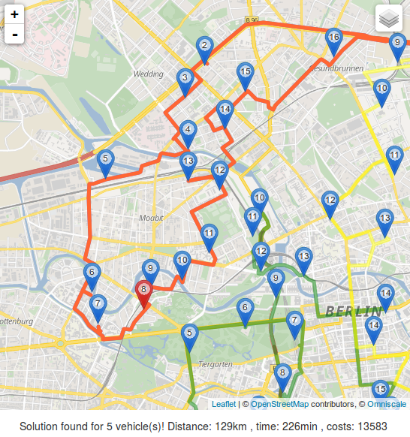

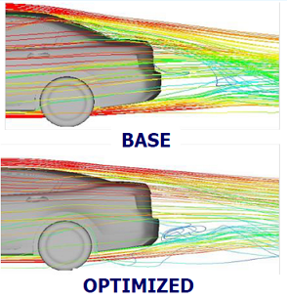
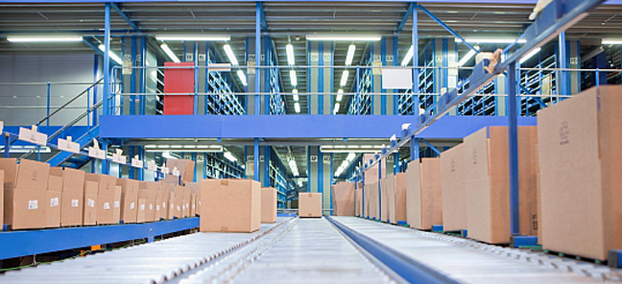
Optimization
The action of making the best or most effective use of a situation or resource.
Electricity
Route
Aerodynamics optimization
Container allocation
Storage optimization
Portfolio optimization
Automobile design optimization
03
Notes:
Electricity
Route
Aerodynamics optimization
Container allocation
Storage optimization
Portfolio optimization
Automobile design optimization
https://www.youtube.com/watch?v=1ypV5ZiIbdA #good examples of optimization

Slide 4
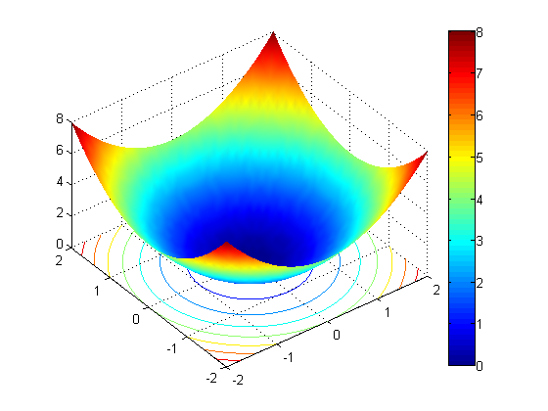
What is Linear Programming
Technique for maximizing or minimizing a linear function of several variables, such as output or cost.
A single Minima
Closed form Solution exists
04

Slide 5
Rule of Thumbs
Identify and name the decision variables consistently
Mathematically define the objective/fitness function in terms of the variables
Identify all stipulated requirements, restrictions and limitations
Express any hidden constraints (generally non-negative or integer only like constraints)
Identify the class of optimization it belongs to
Pick the solution method
05

Slide 6
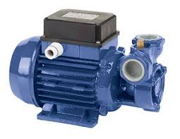
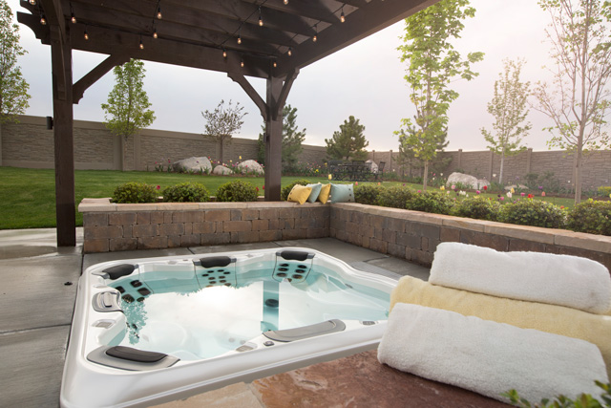
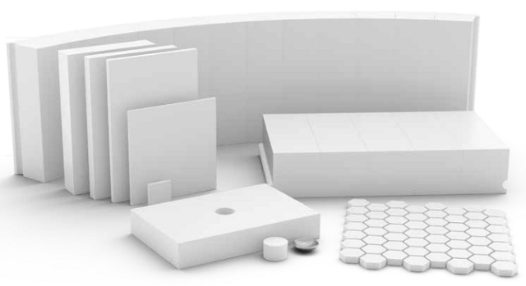
A Sample Problem: Hot tub
06
Notes:
Blue Ridge Hot Tubs manufactures and sells two models of hot tubs: the Aqua-Spa and the Hydro-Lux.
Howie Jones, the owner and manager of the company, needs to decide how many of each type of hot tub to produce during his next production cycle.
Howie buys prefabricated fiberglass hot tub shells from a local supplier and adds the pump and tubing to the shells to create his hot tubs. (This supplier has the capacity to deliver as many hot tub shells as Howie needs.)
Howie installs the same type of pump into both hot tubs. He will have only 200 pumps available during his next production cycle.

Slide 7
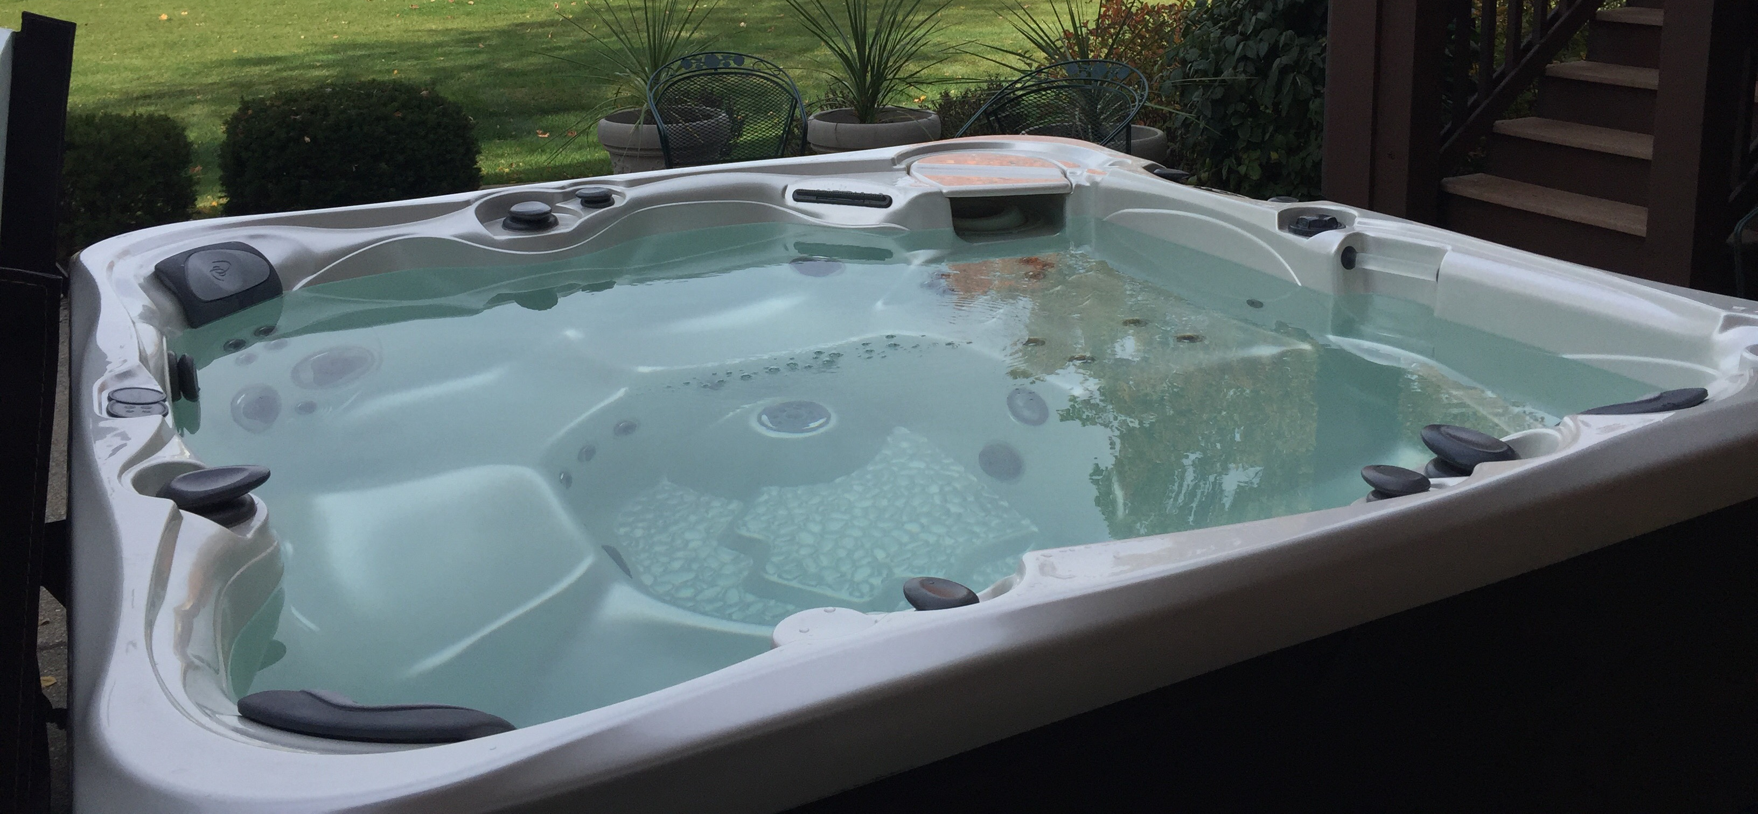

A Sample Problem
9 Hours
6 Hours
12 Feet
16 Feet
07
Notes:
From a manufacturing standpoint, the main difference between the two models of hot tubs is the amount of tubing and labour required. Each Aqua-Spa requires 9 hours of labour and 12 feet of tubing. Each Hydro-Lux requires 6 hours of labour and 16 feet of tubing.
Howie expects to have 1,566 production labour hours and 2,880 feet of tubing available during the next production cycle.
Howie earns a profit of $350 on each AquaSpa he sells and $300 on each Hydro-Lux he sells.
He is confident that he can sell all the hot tubs he produces. The question is, how many AquaSpas and Hydro-Luxes should Howie produce if he wants to maximize his profits during the next production cycle

Slide 8
Identify Decision Variable
v
How many Aqua-Spas and HydroLuxes should be produced?
–We will let X1 represent the number of Aqua-Spas to produce and X2 represent the number of Hydro-Luxes to produce
Mathematically define the objective/fitness function
Howie’s objective of maximizing the profit he earns is stated mathematically as:
MAX: 350X1 + 300X2
08

Slide 9
constraints as Linear combinations
v
R CODE
rm(list=ls(all=TRUE))
par(mfrow=c(1,1))
library(lpSolve)
obj=c(350,300)
con=rbind(c(1,1),
c(9,6),
c(12, 16),
c(1,0),
c(0, 1))
dir=c("<=", "<=", "<=", ">=", ">=")
rhs=c(200, 1566, 2880, 0, 0)
res=lp("max", obj, con, dir, rhs,
compute.sens=1)
#Analyzing the results
res$solution
res
res$sens.coef.from
res$sens.coef.to
Maximize: 350X₁ + 300X₂
Constraints: 1X₁ + 1X₂ ≤ 200
9X₁ + 6X₂ ≤ 1,566
12X₁ + 16X₂ ≤ 2,880
1X₁ ≥ 0
1X₂ ≥ 0
SOL: 350*122 + 300*78 = 66100
09
Notes:
Constraint 1: Only 200 pumps are available and each hot tub requires one pump
Constraint 2: He has only 1,566 labor hours available during the next production cycle. Each Aqua-Spa he builds (each unit of X1) requires 9 labor hours and each HydroLux (each unit of X2) requires 6 labor hours
Constraint 3: Each Aqua-Spa requires 12 feet of tubing, and each Hydro-Lux produced requires 16 feet of tubing
Constraint 4: There are simple lower bounds of zero on the variables X1 and X2 because it is impossible to produce a negative number of hot tubs.

Slide 10
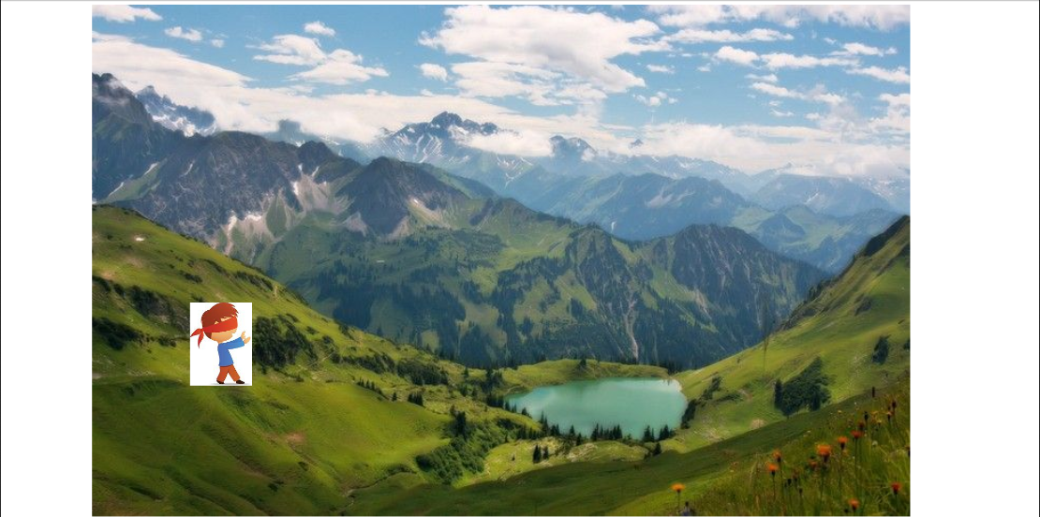
What is Descent?
v
10

Slide 11
What is Gradient Descent
Gradient is the slope of a function.
Optimization is finding the “best” value of a function which is the minimum value of the function.
The number of “turning points” of a function depend on the order of the function.
Not all turning points are minima.
The least of all the minimum points is called the “global” minimum.
Every minimum is a “local” minimum.
11

Slide 12
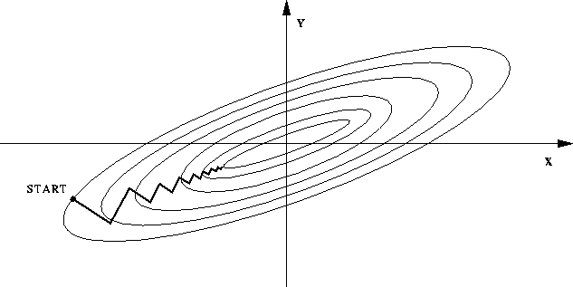
Approach
12

Slide 13
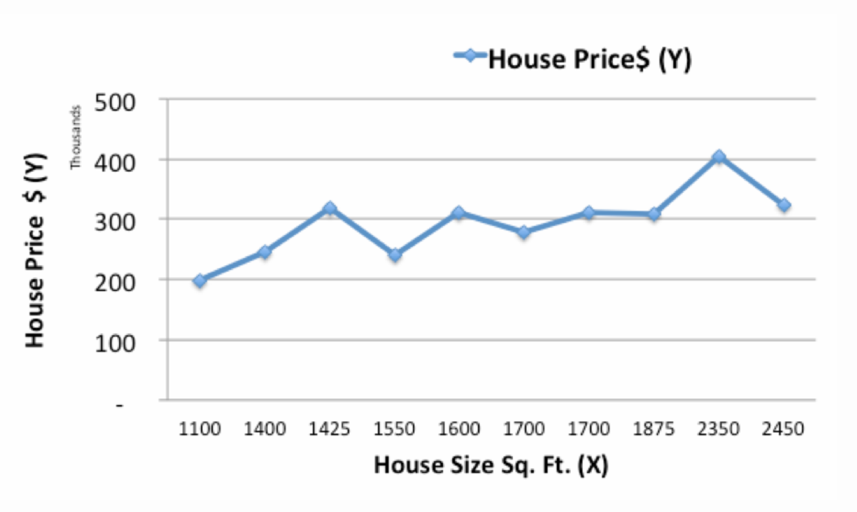
Gradient Descent: Example
House Size (X) | 1400 | 1600 | 1700 | 1875 | 1100 | 1550 | 2350 | 2450 | 1425 | 1700
House Price (Y) | 245,000 | 312,000 | 279,000 | 308,000 | 199,000 | 219,000 | 405,000 | 324,000 | 319,000 | 255,000
13
Notes:
http://www.kdnuggets.com/2017/04/simple-understand-gradient-descent-algorithm.html
To explain this example

Slide 14
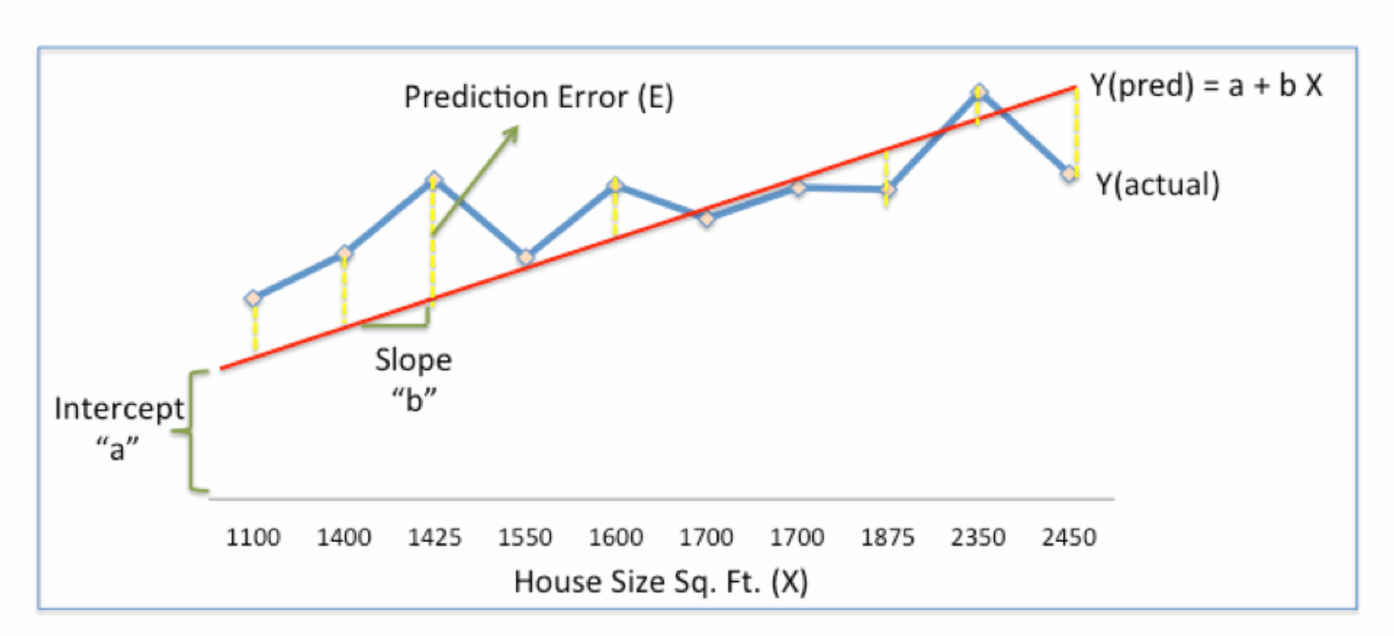
Example
House Size (X) | 1400 | 1600 | 1700 | 1875 | 1100 | 1550 | 2350 | 2450 | 1425 | 1700
House Price (Y) | 245,000 | 312,000 | 279,000 | 308,000 | 199,000 | 219,000 | 405,000 | 324,000 | 319,000 | 255,000
14
Notes:
http://www.kdnuggets.com/2017/04/simple-understand-gradient-descent-algorithm.html
To explain this example

Slide 15
Optimization procedure
Objective is to find optimal a, b that minimizes the error.
Sum of Squared Errors (SSE) = ½ Sum (Actual House Price – Predicted House Price)²= ½ Sum(Y – Ypred)²
Initialize weights
Calculate Gradient
Adjust weights for optimum value
Use new weights for prediction
Repeat 2 and 3 until error is minimized
15
Notes:
http://www.kdnuggets.com/2017/04/simple-understand-gradient-descent-algorithm.html
To explain this example

Slide 16
Standardize
House Size (X) | House Price (Y)
1,100 | 1,99,000
1,400 | 2,45,000
1,425 | 3,19,000
1,550 | 2,40,000
1,600 | 3,12,000
1,700 | 2,79,000
1,700 | 3,10,000
1,875 | 3,08,000
2,350 | 4,05,000
2,450 | 3,24,000
House Size X (X-Min / Max-min) | House Price Y (Y-Min/Max-Min)
0.00 | 0.00
0.22 | 0.22
0.24 | 0.58
0.33 | 0.20
0.37 | 0.55
0.44 | 0.39
0.44 | 0.54
0.57 | 0.53
0.93 | 1
1 | 0.61
16

Slide 17
Step 1:
Predict and calculate the error
A | B | X | Y | YP = A+BX | SSE = ½(Y - YP)^2
0.45 | 0.75 | 0 | 0 | 0.45 | 0.101
 |  | 0.22 | 0.22 | 0.62 | 0.077
 |  | 0.24 | 0.58 | 0.63 | 0.001
 |  | 0.33 | 0.20 | 0.70 | 0.125
 |  | 0.37 | 0.55 | 0.73 | 0.016
 |  | 0.44 | 0.39 | 0.78 | 0.078
 |  | 0.44 | 0.54 | 0.78 | 0.030
 |  | 0.57 | 0.53 | 0.88 | 0.062
 |  | 0.93 | 1.00 | 1.14 | 0.010
 |  | 1.00 | 0.61 | 1.20 | 0.176
 |  |  |  | Total SSE | 0.677
17

Slide 18
Step 2
A | B | X | Y | YP = A+BX | SSE = ½(Y - YP)^2 | ∂SSE/∂a = -(Y –YP) | ∂SSE/∂b = -(Y –YP)
0.45 | 0.75 | 0 | 0 | 0.45 | 0.101 | 0.45 | 0.00
 |  | 0.22 | 0.22 | 0.62 | 0.077 | 0.39 | 0.09
 |  | 0.24 | 0.58 | 0.63 | 0.001 | 0.05 | 0.01
 |  | 0.33 | 0.20 | 0.70 | 0.125 | 0.50 | 0.17
 |  | 0.37 | 0.55 | 0.73 | 0.016 | 0.18 | 0.007
 |  | 0.44 | 0.39 | 0.78 | 0.078 | 0.39 | 0.18
 |  | 0.44 | 0.54 | 0.78 | 0.030 | 0.24 | 0.11
 |  | 0.57 | 0.53 | 0.88 | 0.062 | 0.35 | 0.20
 |  | 0.93 | 1.00 | 1.14 | 0.010 | 0.14 | 0.13
 |  | 1.00 | 0.61 | 1.20 | 0.176 | 0.59 | 0.59
 |  |  |  | Total SSE | 0.677 | 3.300 | 1.545
Calculate the error gradient w.r.t the weights
∂SSE/∂a = – (Y-YP)
∂SSE/∂b = – (Y-YP)X
SSE=½ (Y-YP)² = ½(Y-(a+bX))²
∂SSE/∂a and ∂SSE/∂b are the gradients and they give the direction of the movement of a,b w.r.t to SSE.
18

Slide 19
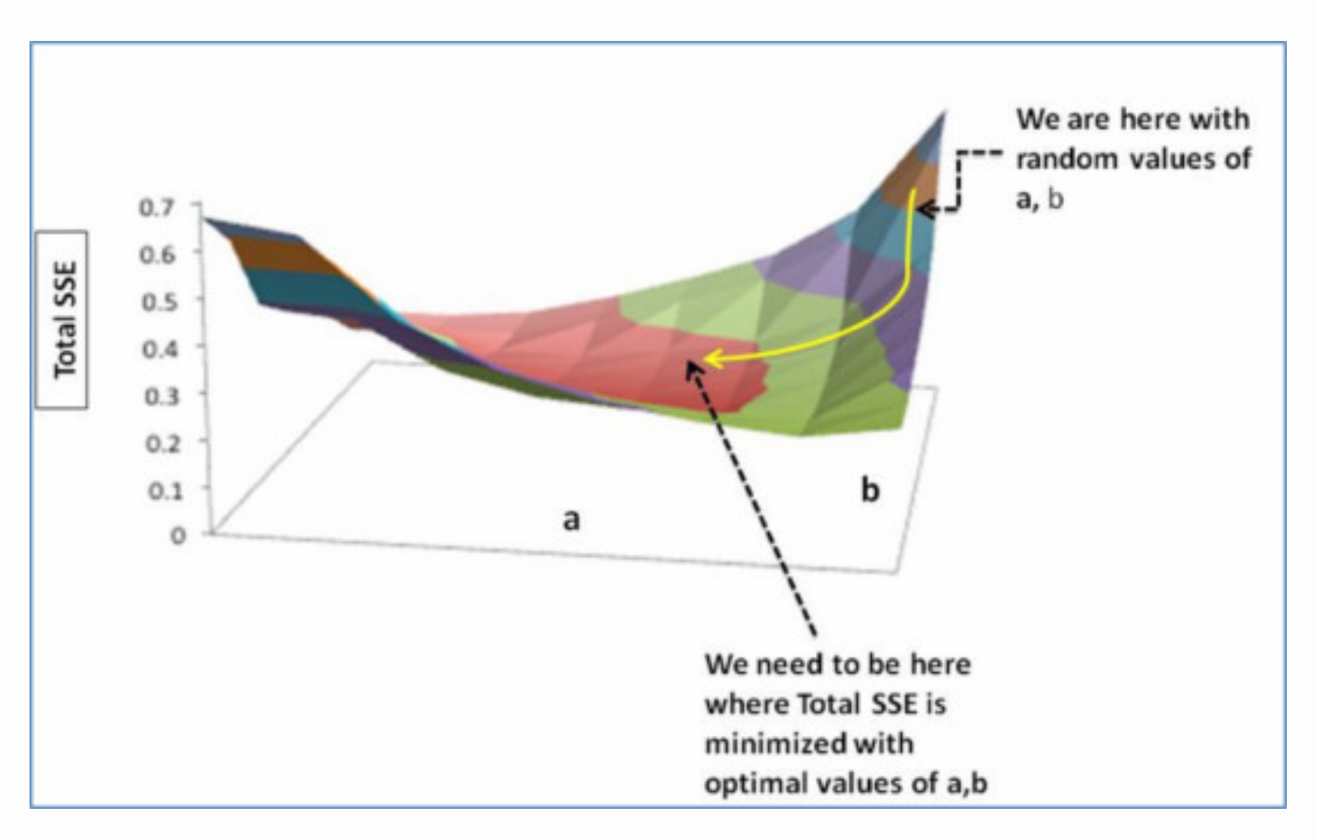
Step 3
Update rules:
a – ∂SSE/∂a
b – ∂SSE/∂b
New a = a – r * ∂SSE/∂a = 0.45-0.01*3.300 = 0.42
New b = b – r * ∂SSE/∂b= 0.75-0.01*1.545 = 0.73
19

Slide 20
Step 4
A | B | X | Y | YP = A+BX | SSE = ½(Y - YP)^2 | ∂SSE/∂a = -(Y –YP) | ∂SSE/∂b = -(Y –YP)
0.42 | 0.73 | 0 | 0 | 0.42 | 0.087 | 0.42 | 0.00
 |  | 0.22 | 0.22 | 0.58 | 0.064 | 0.36 | 0.08
 |  | 0.24 | 0.58 | 0.59 | 0.000 | 0.01 | 0.00
 |  | 0.33 | 0.20 | 0.66 | 0.107 | 0.46 | 0.15
 |  | 0.37 | 0.55 | 0.69 | 0.010 | 0.14 | 0.05
 |  | 0.44 | 0.39 | 0.74 | 0.063 | 0.36 | 0.16
 |  | 0.44 | 0.54 | 0.74 | 0.021 | 0.20 | 0.09
 |  | 0.57 | 0.53 | 0.84 | 0.048 | 0.31 | 0.18
 |  | 0.93 | 1.00 | 1.10 | 0.005 | 0.10 | 0.09
 |  | 1.00 | 0.61 | 1.15 | 0.148 | 0.54 | 0.54
 |  |  |  | Total SSE | 0.553 | 3.300 | 1.545
20

Slide 21
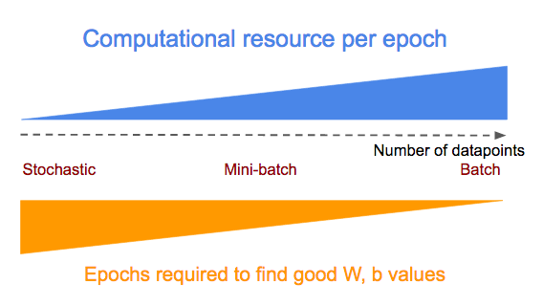
Batch-gradient Descent
Computes the gradient of the cost function w.r.t. to the parameters θ for the entire training dataset
Very slow, memory fill-up, no-online support
for i in range(nb_epochs):
params_grad = evaluate_gradient(loss_function, data, params)
params = params - learning_rate * params_grad
21

Slide 22
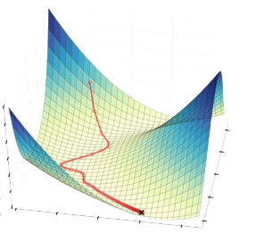
Stocastic gradient Descent
Stochastic gradient descent (SGD) performs a parameter update for each training example x(i)x(i) and label y(i)
for i in range(nb_epochs):
np.random.shuffle(data)
for example in data:
params_grad = evaluate_gradient(loss_function, example, params)
params = params - learning_rate * params_grad
22

Slide 23
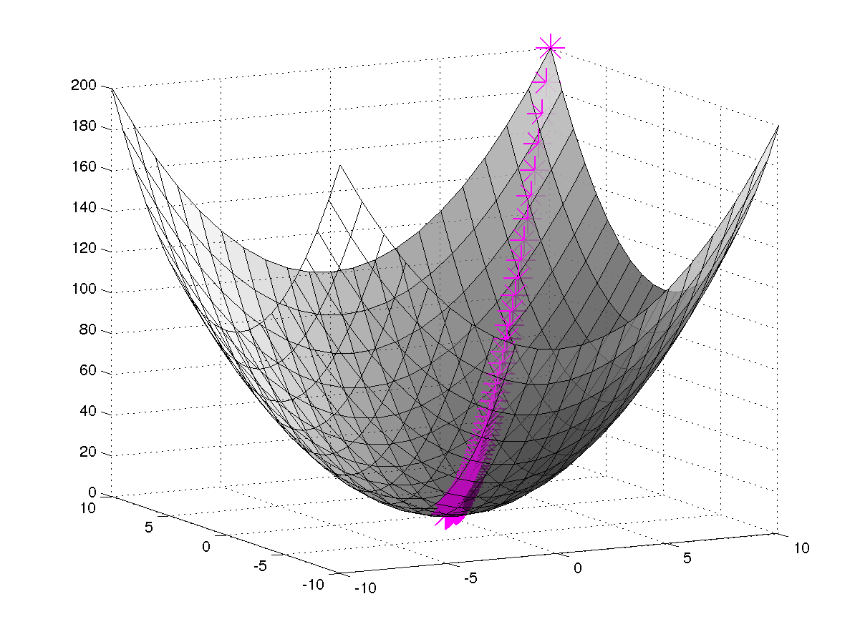
Mini-batch gradient Descent
Mini-batch gradient descent splits the training dataset into small batches that are used to calculate model error and update model coefficients.
for i in range(nb_epochs):
np.random.shuffle(data)
for batch in get_batches(data, batch_size=50):
params_grad = evaluate_gradient(loss_function, batch, params)
params = params - learning_rate * params_grad
23
Notes:
https://www.youtube.com/watch?v=4BZBog1Zx6c

Slide 24
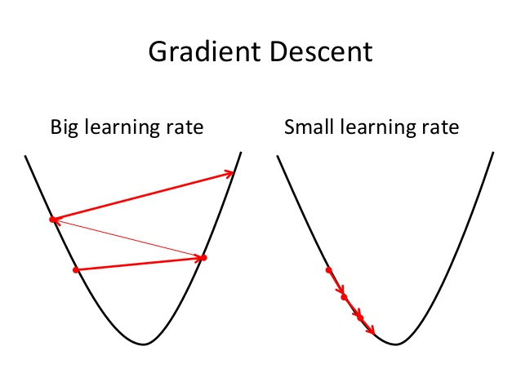
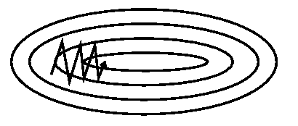
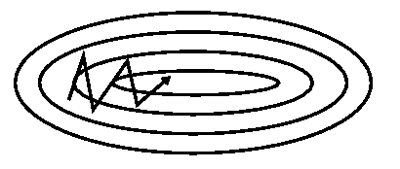
Other parameters
Learning rate (λ): It is by what step should you update the error.
If the λ is very large we will skip the optimal solution.
If it is too small we will need too many iterations to converge to the best values.
Momentum: It is a method that helps accelerate SGD in the relevant direction and dampens oscillations.
Without momentum
With momentum
24
Notes:
https://www.youtube.com/watch?v=4BZBog1Zx6c

